Slide 1
I&F with Adaptation
Chang Yan, Jingguo Liang

Slide 2
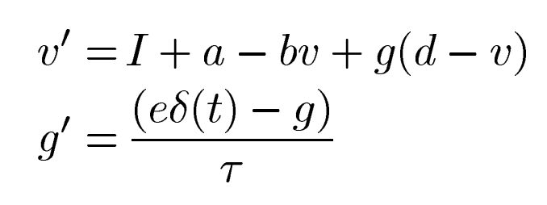
Model and parameters
V: membrane potential = -70 mV at rest, -80 mV at reset (overshoot) I: Stimulus current V_th: Threshold voltage = -55mV
a: constant voltage change = -10 mV/s b: leaky term = 10mA/V
d: K+ Nernst potential = -90 mV g: K+ activation gate τ: time constant of K+ activation gate = 5ms
eδ(t): adaptation term

Slide 3
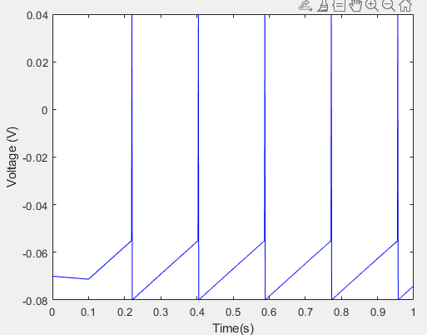
（A）tonic spiking
I: Stimulus current

Slide 4
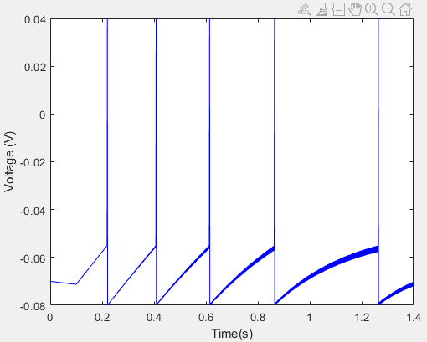
（B）spike frequency adaptation
I: Stimulus current

Slide 5
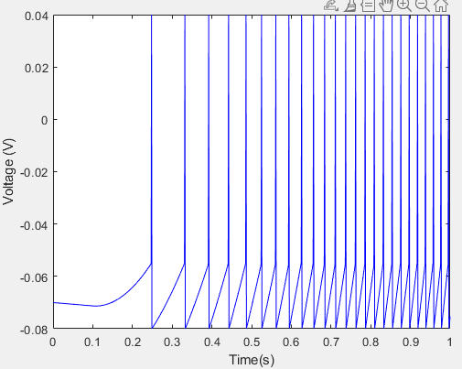
（C）Class 1 excitable
I: Stimulus current

Slide 6
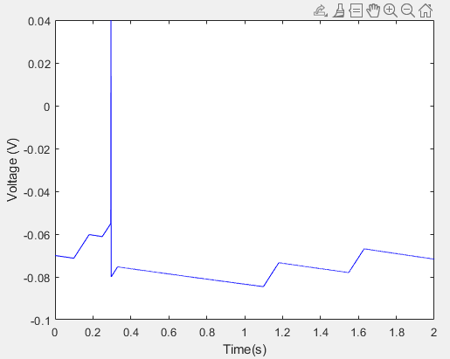
（D）integrator
I: Stimulus current

Slide 7
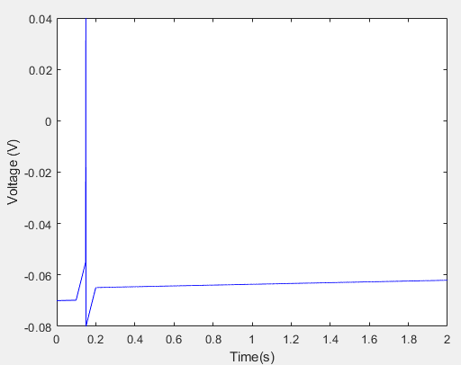
（E）Depolarizing after potential
I: Stimulus current

